Slide 1
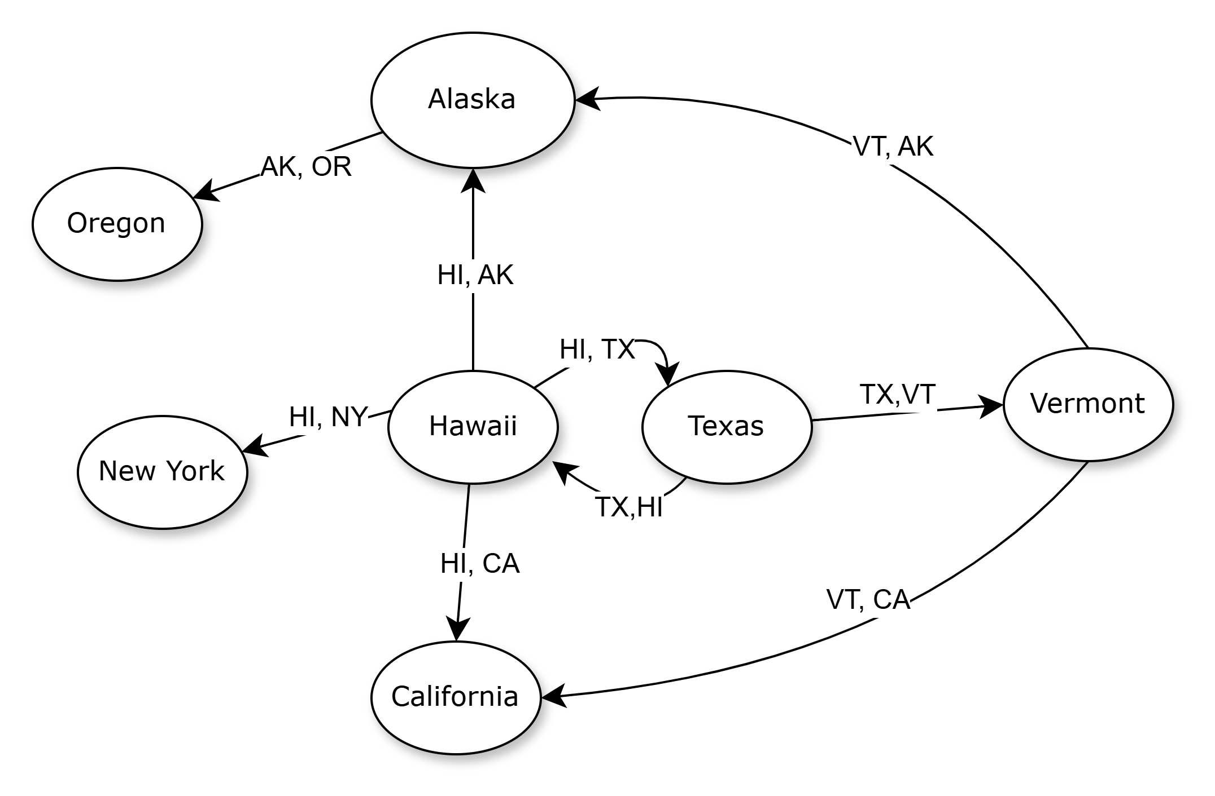





CMSC204
Kartchner
V(StateGraph) = {Oregon, Alaska, Texas, Hawaii, Vermont, NewYork, California}
E(StateGraph) = {(Alaska, Oregon), (Hawaii, Alaska), (Hawaii, Texas), (Texas, Hawaii), (Hawaii, California), (Hawaii, New York), (Texas, Vermont), (Vermont, California), (Vermont, Alaska)}
1. Draw the StateGraph

Slide 2



a. Show the adjacency matrix that would describe the edges in the graph. Store the vertices in alphabetical order
States
0 | 0 | 0 | 0 | 0 | 0 | 0
1 | 0 | 0 | 0 | 0 | 0 | 0
0 | 0 | 0 | 1 | 1 | 0 | 0
0 | 1 | 1 | 0 | 0 | 1 | 1
0 | 1 | 0 | 0 | 0 | 0 | 1
0 | 0 | 0 | 0 | 0 | 0 | 0
0 | 0 | 0 | 0 | 0 | 0 | 0
OR
AK
TX
HI
VT
NY
CA
OR
AK
TX
HI
VT
NY
CA
3. b. Show the adjacency lists
that would describe the edges in the graph
OR:
AK: OR
TX: HI, VT
HI: TX, CA, NY, AK
VT: AK, CA
NY:
CA:

Slide 3
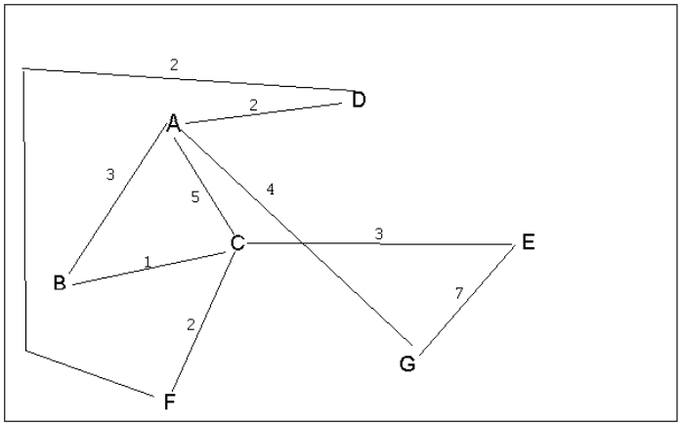


4 a. Which of the following lists the graph nodes in depth first order beginning with E?
A) E, G, F, C, D, B, A
B) G, A, E, C, B, F, D
C) E, G, A, D, F, C, B
D) E, C, F, B, A, D, G
4 b. Which of the following lists the graph nodes in breadth first order beginning at F?
A) F, C, D, A, B, E, G
B) F, D, C, A, B, C, G
C) F, C, D, B, G, A, E
D) a, b, and c are all breadth first traversals

Slide 4
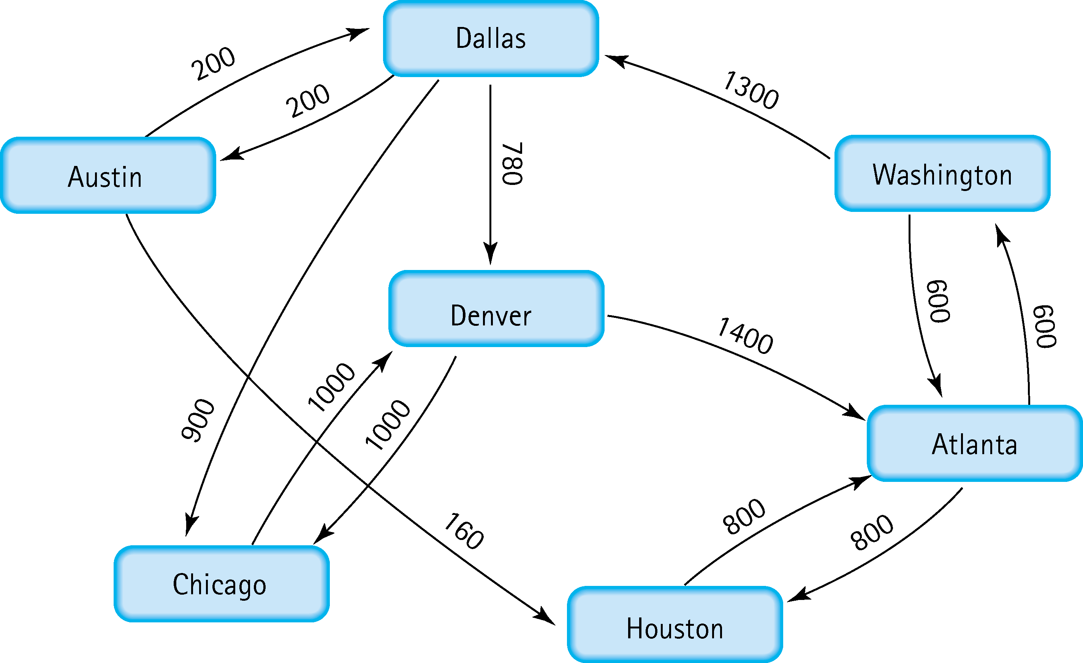
5. Find the shortest distance from Atlanta to every other city
Atlanta to Atlanta = 0
Atlanta to Washington = 600
Atlanta to Houston = 800
Atlanta to Denver = 960
Atlanta to Dallas = 1300
Atlanta to Austin = 1500
Atlanta to Chicago = 1960

Slide 5
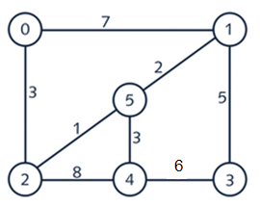
6. Find the minimal spanning tree using Prim’s algorithm. Use
0 as the source vertex . Show the steps.
 | Select cheapest: | Visited | MST edges | Candidate edges
Steps | Start: 0 | {0} | [ ] | {(0,2, weight = 3), (0,1, weight =7)}
1 | (0,2) =3 | {0, 2} | [(0,2,3)] | add(2,5, weight = 1), remove(0,2), (0,1, weight =7), add(2,4, weight = 8)}
2 | (2,5) =1 | {0,2,5} | [(0,2,3), (2,5,1)] | {remove(2,5), add(5,1,weight=2), (0,1, weight =7), (2,4, weight = 8)}
3 | (5,1) =2 | {0,2,5,1} | [(0,2,3), (2,5,1), (5,1,2)] | {remove(5,1), add(5,4, weight=3), add(1,3,weight=5), ignore(0,1, weight =7), (2,4, weight = 8)}
4 | (5,4) =3 | {0,2,5,1,4} | [(0,2,3), (2,5,1), (5,1,2), (5,4,3)] | { (1,3, weight=5), add(3,4, weight=6), remove(5,4), remove(2,4)}
5 | (1,3) =5 | {0,2,5,1,4,3} | [(0,2,3), (2,5,1), (5,1,2), (5,4,3), (1,3,5)] | { remove(1,3), remove(3,4)}
Done | Total weight of MST: 3+1+2+3+5 = 14 | all vertices are Visited | Edges: (0,2), (2,5), (5,1), (5,4), (1,3)

Slide 6
7. Find the minimal spanning tree using Kruskal’s algorithm.
Show the weights in order and the steps.
 | Add edge: | sets | MST edges
Steps | Start: 0 | {0} | [ ]
1 | (2,5) =1 | {0}, {1}, {2,5}, {3}, {4} | {(2,5)} | Does not create cycle
2 | (1,5) =2 | {0}, {1,2,5}, {3}, {4} | {(2,5), (1,5)} | Does not connect vertices already in the set (1,5)
3 | (0,2)=3 | {0,1,2,5}, {3}, {4} | {(2,5), (1,5), (0,2)} | Does not connect vertices already in the set (0,2)
4 | (4,5) =3 | {0,1,2,4,5}, {3} | {(2,5), (1,5), (0,2), (4,5)} | Does not connect vertices already in the set (4,5)
5 | (1,3) =5 | {0,1,2,4,5, 3} | {(2,5), (1,5), (0,2), (4,5), (1,3)} | Does not connect vertices already in the set (1,3)
Done | Total weight of MST: 1+2+3+3+5= 14

Slide 7
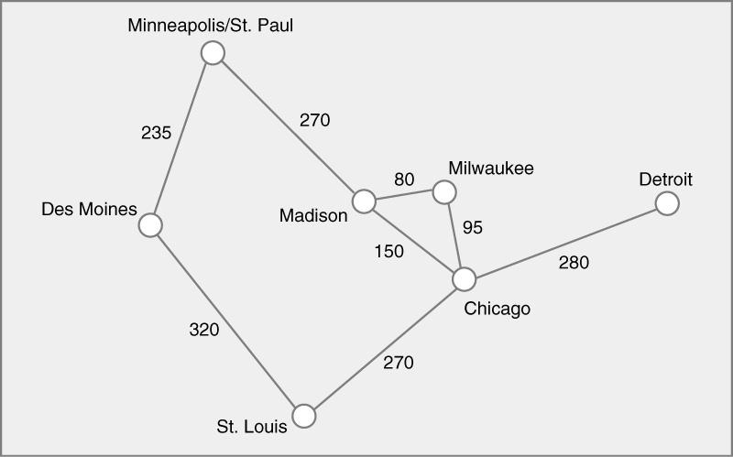
8. Find the minimal spanning tree using the algorithm you prefer. Use
Minneapolis/St. Paul as the source vertex
 | Extract minimum weight edge from priorityQueue | Visited | MST edges | priorityQueue (edge : weight)
Steps | Start: MSP | {MSP} | [ ] | {(MSP, DM): 235), (MSP, Mad): 270}
1 | (MSP, DM): 235 | {MSP, DM} | [(MSP, DM, 235)] | {(MSP, Mad): 270), (DM, STL) : 320}
2 | (MSP, Mad): 270 | {MSP, DM, Mad} | [(MSP, DM, 235), (MSP, Mad, 270)] | {(Mad, Mil): 80, (Mad, Chi): 150, (DM, STL): 320}
3 | (Mad, Mil): 80 | {MSP, DM, Mad, Mil} | [(MSP, DM, 235), (MSP, Mad, 270), (Mad, Mil, 80)] | {(Mil, Chi): 95, (Mad, Chi): 150, (DM, STL): 320}
4 | (Mil, Chi): 95 | {MSP, DM, Mad, Mil, Chi} | [(MSP, DM, 235), (MSP, Mad, 270), (Mad, Mil, 80), (Mil, Chi, 95)] | {(Mad, Chi): 150, (Chi, STL): 270, (Chi, Det): 280, (DM, STL): 320}
5 | (Mad, Chi): 150 -> Discard (Chi visited) (Chi, STL): 270 | {MSP, DM, Mad, Mil, Chi, STL} | [(MSP, DM, 235), (MSP, Mad, 270), (Mad, Mil, 80), (Mil, Chi, 95), (Chi, STL, 270)] | {(Chi, Det): 280, (DM, STL): 320}
Done | (Chi, Det): 280 (DM, STL): 320 -> Discard (STL visited) | {MSP, DM, Mad, Mil, Chi, STL, Det} | Final Edges: (MSP, DM, 235) (MSP, Mad, 270) (Mad, Mil, 80) (Mil, Chi, 95) (Chi, STL, 270) (Chi, Det, 280) | [] (Empty or only edges to visited nodes)
 | Total weight of MST: 235 + 270 + 80 + 95 + 270 + 280 = 1230 | all vertices are Visited
Screen shot is provided of GitHub repo with Graph Lab file

Slide 8
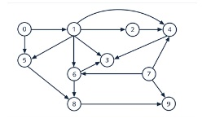
9. List the nodes of the graph in a breadth first topological ordering. Show the
steps using arrays predCount, topologicalOrder and a queue
Initialize Queue: 7 has predCount 0
Initialize topologicalOrder array: [ ]
Initialize orderIndex: 0
Vertices: 0,1,2,3,4,5,6,7,8,9 (V= 10)
Edges:
0 -> 1, 0 -> 5
1 -> 2, 1 -> 4, 1 -> 6
2 -> 4
3 -> 6
4 -> 3
5 -> 6, 5 -> 8
6 -> 8
7 -> 4, 7 -> 9
8 -> 9
Initial predCount (In-degree):
predCount = 0
predCount = 1 =1 (from 0)
predCount = 2 =1 (from 1)
predCount = 3 = 1 (from 4)
predCount = 4 = 3 (from 1,2,7)
predCount = 5 = 1 (from 0)
predCount = 6 = 3 (from 1,3,5)
predCount = 7 = 0
predCount = 8 = 2 (from 5,6)
predCount = 9 =2 (from 7,8)
FINAL TOPOLOGICAL ORDER:
[7] [1][5][2][4][3][6][8][9]
Step | Action | Queue | predCount Array | topologicalOrder Array (Up to orderIndex)
0 | Initial | [7] | [1][1][1][3][1][3][2][2] | []
1 | Dequeue 0 | [7] | [1][1][1][3][1][3][2][2] | ``
 | Neighbors 1,5 | [7][1][5] | [1][1][3][3][2][2] | ``
2 | Dequeue 7 | [1][5] | [1][1][3][3][2][2] | [7]
 | Neighbors 4,9 | [1][5] | [1][1][2][3][2][1] | [7]
3 | Dequeue 1 | [5] | [1][1][2][3][2][1] | [7][1]
 | Neighbors 2,4,6 | [5][2] | [1][1][2][2][1] | [7][1]
4 | Dequeue 5 | [2] | [1][1][2][2][1] | [7][1][5]
 | Neighbors 6,8 | [2] | [1][1][1][1][1] | [7][1][5]
5 | Dequeue 2 | [] | [1][1][1][1][1] | [7][1][5][2]
 | Neighbor 4 | [4] | [1][1][1][1] | [7][1][5][2]
6 | Dequeue 4 | [] | [1][1][1][1] | [7][1][5][2][4]
 | Neighbor 3 | [3] | [1][1][1] | [7][1][5][2][4]
7 | Dequeue 3 | [] | [1][1][1] | [7][1][5][2][4][3]
 | Neighbor 6 | [6] | [1][1] | [7][1][5][2][4][3]
8 | Dequeue 6 | [] | [1][1] | [7][1][5][2][4][3][6]
 | Neighbor 8 | [8] | [1] | [7][1][5][2][4][3][6]
9 | Dequeue 8 | [] | [1] | [7][1][5][2][4][3][6][8]
 | Neighbor 9 | [9] | `` | [7][1][5][2][4][3][6][8]
10 | Dequeue 9 | [] | `` | [7][1][5][2][4][3][6][8][9]
 | No Neighbors | [] | `` | [7][1][5][2][4][3][6][8][9]

Slide 9
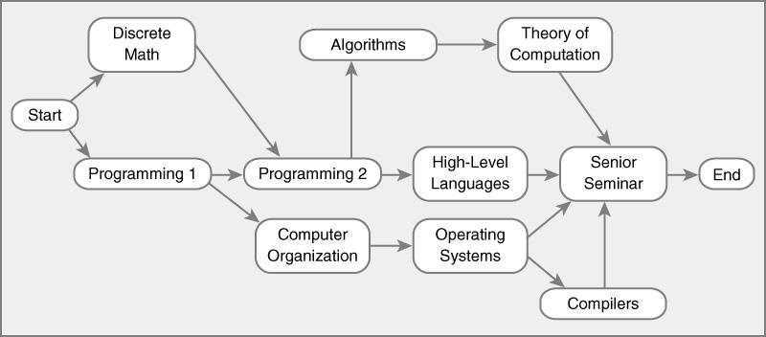
10. List the nodes of the graph in a breadth first topological ordering.
Start, Discrete Math, Programming 1, Programming 2, Computer Organization, Algorithms, High-Level Languages, Operating Systems, Theory of Computation, Compilers, Senior Seminar, End

